Slide 1
CS 6234 Advanced Algorithms:
Splay Trees, Fibonacci Heaps, Persistent Data Structures

Slide 2
Splay Trees
Muthu Kumar C., Xie Shudong
Fibonacci Heaps
Agus Pratondo, Aleksanr Farseev
Persistent Data Structures:
Li Furong, Song Chonggang
Summary
Hong Hande

Slide 3
SOURCES:
Splay Trees
Base slides from: David Kaplan, Dept of Computer Science & Engineering, Autumn 2001
CS UMD Lecture 10 Splay Tree
UC Berkeley 61B Lecture 34 Splay Tree
Fibonacci Heap
Lecture slides adapted from:
Chapter 20 of Introduction to Algorithms by Cormen, Leiserson, Rivest, and Stein.
Chapter 9 of The Design and Analysis of Algorithms by Dexter Kozen.
Persistent Data Structure
Some of the slides are adapted from:
http://electures.informatik.uni-freiburg.de

Slide 4
Pre-knowledge: Amortized Cost Analysis
  Amortized Analysis
    Upper bound, for example, O(log n)
    Overall cost of a arbitrary sequences
    Picking a good “credit” or “potential” function
  Potential Function: a function that maps a data structure onto a real valued, nonnegative “potential”
    High potential state is volatile, built on cheap operation
    Low potential means the cost is equal to the amount allocated to it
    Amortized Time = sum of actual time + potential change

Slide 5
Splay Tree
Muthu Kumar C.
Xie Shudong

Slide 6
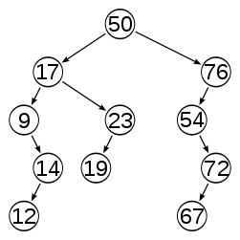
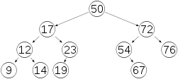
Background
Balanced Binary Search Trees
Unbalanced binary search tree
Balanced binary search tree
y
Zig
x
x
C
A
y
Balancing by rotations
Rotations preserve the BST property
A
B
B
C

Slide 7
Motivation for Splay Trees
Problems with AVL Trees
  Extra storage/complexity for height fields
  Ugly delete code
Solution: Splay trees (Sleator and Tarjan in 1985)
  Go for a tradeoff by not aiming at balanced trees always.
  Splay trees are self-adjusting BSTs that have the additional helpful property that more commonly accessed nodes are more quickly retrieved.
  Blind adjusting version of AVL trees.
  Amortized time (average over a sequence of inputs) for all operations is O(log n).
  Worst case time is O(n).
Notes:
Amortization happens due to splaying. Future accesses are not o(n). Future access to nodes that were on the path to the splayed node are also faster.

Slide 8
Splay Tree Key Idea
10
You’re forced to make
a really deep access:
17
Since you’re down there anyway,
fix up a lot of deep nodes!
5
2
9
3
Why splay?
This brings the most recently accessed nodes up towards the root.

Slide 9
Splaying
Bring the node being accessed to the root of the tree, when accessing it, through one or more splay steps.
A splay step can be:
Zig Zag
Zig-zig Zag-zag
Zig-zag Zag-zig
Single rotation
Double rotations

Slide 10
Splaying Cases
Node being accessed (n) is:
  the root
  a child of the root
  Do single rotation: Zig or Zag pattern
  has both a parent (p) and a grandparent (g)
  Double rotations:
    (i) Zig-zig or Zag-zag pattern:
    g → p → n is left-left or right-right
    (ii) Zig-zag pattern:
    g → p → n is left-right or right-left

Slide 11
Case 0: Access root
Do nothing (that was easy!)
root
root
n
n
X
Y
X
Y

Slide 12
Case 1: Access child of root
Zig and Zag (AVL single rotations)
root
root
p
Zig – right rotation
n
n
Z
Zag – left rotation
X
p
X
Y
Y
Z
Notes:
In the case where we’re just one step away from the root, we single rotate.
Now, each of these helped and hurt an equal number of nodes at each step,
but other than this final zig, our node always helped its children, right?
Therefore, every single node except p, Y, and Z in this picture improves (some quite a lot).
How bad are things for p, Y, and Z?
each might be down one level from where it used to be.
How good are things for n and many of its descendants and former ancestors?
Very good.
Why not zig all the way (no zig-zig)?
This just helps _one_ child of n!

Slide 13
Case 1: Access child of root:
Zig (AVL single rotation) - Demo
Zig
root
p
n
Z
X
Y
Notes:
In the case where we’re just one step away from the root, we single rotate.
Now, each of these helped and hurt an equal number of nodes at each step,
but other than this final zig, our node always helped its children, right?
Therefore, every single node except p, Y, and Z in this picture improves (some quite a lot).
How bad are things for p, Y, and Z?
each might be down one level from where it used to be.
How good are things for n and many of its descendants and former ancestors?
Very good.
Why not zig all the way (no zig-zig)?
This just helps _one_ child of n!

Slide 14
Case 2: Access (LR, RL) grandchild:
Zig-Zag (AVL double rotation)
g
n
X
p
g
p
n
W
X
Y
Z
W
Y
Z

Slide 15
Case 2: Access (LR, RL) grandchild:
Zig-Zag (AVL double rotation)
g
Zig
X
p
n
W
Y
Z

Slide 16
Case 2: Access (LR, RL) grandchild:
Zig-Zag (AVL double rotation)
Zag
g
X
n
Y
p
Z
W

Slide 17
Case 3: Access (LL, RR) grandchild:
Zag-Zag (different from AVL)
g
1
n
2
W
p
p
Z
X
n
g
Y
Y
Z
W
X
No more cookies! We are done showing animations.
Notes:
Can anyone tell me how to implement this with two rotations?
There are two possibilities:
Start with rotate n
or rotate p?
Rotate p!
Rotate n makes p n’s left child and then we’re hosed.
Then, rotate n.
This helps all the nodes in blue and hurts the ones in red. So, in some sense, it helps and hurts the same number of nodes on one rotation.
Question: what if we keep rotating? What happens to this whole subtree?
It gets helped!

Slide 18
Quick question
In a splay operation involving several splay steps (>2), which of the 4 cases do you think would be used the most?
Do nothing | Single rotation | Double rotation cases
Zig
y
x
z
n
x
y
y
D
x
C
A
Zig-Zag
A
B
y
z
A
B
B
C
A
x
B
C
A
B
C
D

Slide 19
Why zag-zag splay-op is better than a sequence of zags (AVL single rotations)?
6
1
1
1
2
2
zag
zags
2
3
3
………
4
3
4
6
4
5
Tree still unbalanced.
No change in height!
5
5
6
Notes:
Series of AVL single rotations.. Creates a very unbalanced tree. Instead top-down zag-zag leaves a tree that is about half the size of the original

Slide 20
Why zag-zag splay-step is better than a sequence of zags (AVL single rotations)?
1
1
1
6
2
2
2
1
3
3
3
…
3
4
5
6
2
5
5
4
6
5
4
6
4
Notes:
Series of AVL single rotations.. Creates a very unbalanced tree. Instead top-down zag-zag leaves a tree that is half the size of the original

Slide 21
Why Splaying Helps
If a node n on the access path, to a target node say x, is at depth d before splaying x, then it’s at depth <= 3+d/2 after the splay. (Proof in Goodrich and Tamassia)
Overall, nodes which are below nodes on the access path tend to move closer to the root
Splaying gets amortized to give O(log n) performance. (Maybe not now, but soon, and for the rest of the operations.)
Notes:
We decided that splaying a node to the root of a search tree would help because we’d do a lot of fixing up if we had an expensive access.
That means we have to fix up the tree on every expensive access.

Slide 22
Splay Operations: Find
Find the node in normal BST manner
Note that we will always splay the last node on the access path even if we don’t find the node for the key we are looking for.
Splay the node to the root
Using 3 cases of rotations we discussed earlier
Notes:
So, on find we just splay the sought-after node to the root.

Slide 23
Splaying Example: using find operation
1
1
2
2
zag-zag
3
3
Find(6)
4
6
5
5
6
4

Slide 24
… still splaying …
1
1
2
6
zag-zag
3
3
6
2
5
5
4
4

Slide 25
… 6 splayed out!
1
6
6
1
zag
3
3
2
5
2
5
4
4

Slide 26
Splay Operations: Insert
Can we just do BST insert?
Yes. But we also splay the newly inserted node up to the root.
Alternatively, we can do a Split(T,x)
Notes:
What about insert?
Ideas?
Can we just do BST insert?
NO. Because then we could do an expensive operation without fixing up the tree.

Slide 27
Digression: Splitting
Split(T, x) creates two BSTs L and R:
  all elements of T are in either L or R (T = L ∪ R)
  all elements in L are ≤ x
  all elements in R are ≥ x
  L and R share no elements (L ∩ R = ∅)
Notes:
OK, let’s talk about something completely unrelated before we hit insertion.
Splitting a tree just does what you might expect.
Make two trees, one has everything <= x, one has everything >= x.

Slide 28
Splitting in Splay Trees
How can we split?
  We can do Find(x), which will splay x to the root.
  Now, what’s true about the left subtree L and right subtree R of the root?
  So, we simply cut the tree at x, attach x either L or R
Notes:
How can we implement this?
We can splay.
We can find x or where x ought to be.
We can splay that spot to the root.
Now, what do we have?
The left subtree is all <= x
The right is all >= x

Slide 29
Split
split(x)
T
splay
L
R
OR
L
R
L
R
  ≤ x
> x
< x
  ≥ x
Notes:
So, a split just splays x’s spot to the root then hacks off one subtree.

Slide 30
Back to Insert
x
split(x)
L
R
L
R
< x
> x
Notes:
Now, If we can split on x and produce one subtree smaller and one larger than x, insert is easy!
Just split on x.
Then, hang the left (smaller) subtree on the left of x.
Hang the right (larger) subtree on the right of x.
Pretty simple, huh?
Are we fixing up deep paths?

Slide 31
Insert Example
4
4
6
6
split(5)
1
6
1
9
1
9
2
9
2
7
4
7
7
2
5
4
6
Insert(5)
1
9
2
7

Slide 32
Splay Operations: Delete
Do a BST style delete and splay the parent of the deleted node. Alternatively,
x
find(x)
delete (x)
L
R
L
R
< x
> x
Notes:
OK, we’ll do something similar for delete.
We know x is in the tree.
Find it and bring it to the root.
Remove it.
Now, we have two split subtrees.
How do we put them back together?

Slide 33
Join
Join(L, R): given two trees such that L < R, merge them
Splay on the maximum element in L, then attach R
L
L
R
R
splay
Notes:
The join operation puts two subtrees together as long as one has smaller keys to begin with.
First, splay the max element of L to the root.
Now, that’s gauranteed to have no right child, right?
Just snap R onto that NULL right side of the max.

Slide 34
Delete Completed
x
T
find(x)
delete x
L
R
L
R
< x
> x
Join(L,R)
T - x
Notes:
So, we just join the two subtrees for delete.

Slide 35
Delete Example
4
6
6
1
6
1
9
1
9
find(4)
2
9
2
7
4
7
Find max
7
2
2
2
1
6
1
6
Delete(4)
9
9
Compare with BST/AVL delete on ivle
7
7

Slide 36
Splay implementation – 2 ways
Bottom-up Top Down
y
Zig
x
L
y
R
L
R
Zig
x
x
C
A
y
x
C
A
B
A
B
B
C
A
B
y
C
Why top-down?
Bottom-up splaying requires traversal from root to the node that is to be splayed, and then rotating back to the root – in other words, we make 2 tree traversals. We would like to eliminate one of these traversals.¹
How? time analysis.. We may discuss on ivle.
1. http://www.csee.umbc.edu/courses/undergraduate/341/fall02/Lectures/Splay/ TopDownSplay.ppt

Slide 37
Splay Trees: Amortized Cost Analysis
Amortized cost of a single splay-step
Amortized cost of a splay operation: O(logn)
Real cost of a sequence of m operations: O((m+n) log n)

Slide 38
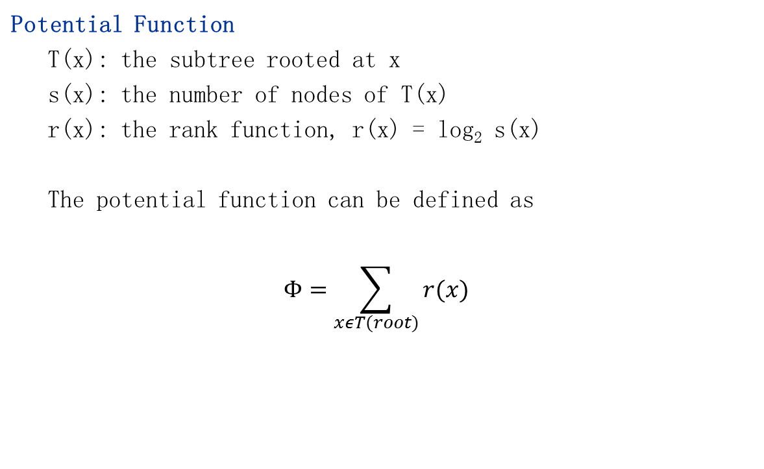
Splay Trees: Amortized Cost Analysis

Slide 39


Splay Trees Amortized Cost Analysis
Amortized cost of a single splay-step
Lemma 1: For a splay-step operation on x that transforms the rank function r into r’, the amortized cost is:
(i) a_{i} ≤ 3(r’(x) − r(x)) + 1 if the parent of x is the root, and
(ii) a_{i} ≤ 3(r’(x) − r(x)) otherwise.
y
Zig
x
z
y
y
Zig-Zag
x
x
y
z
x

Slide 40
Splay Trees Amortized Cost Analysis
Lemma 1: (i) a_{i} ≤ 3(r’(x) − r(x)) + 1 if the parent of x is the root, and
(ii) a_{i} ≤ 3(r’(x) − r(x)) otherwise.
Proof :
We consider the three cases of splay-step operations (zig/zag, zigzig/zagzag, and zigzag/zagzig).
Case 1 (Zig / Zag) : The operation involves exactly one rotation.
Amortized cost is a_{i} = c_{i} + φ’ − φ
Real cost c_{i} = 1
x
y
x
y
Zig

Slide 41
Splay Trees Amortized Cost Analysis
Amortized cost is a_{i} = 1 + φ’ − φ
In this case, we have r’(x)= r(y), r’(y) ≤ r’(x) and r’(x) ≥ r(x).
So the amortized cost:
a_{i} = 1 + φ’ − φ
= 1 + r’(x) + r’(y) − r(x) − r(y)
= 1 + r’(y) − r(x)
≤ 1 + r’(x) − r(x)
≤ 1 + 3(r’(x) − r(x))
y
x
x
y
Zig

Slide 42


Splay Trees Amortized Cost Analysis
Lemma 1: (i) a_{i} ≤ 3(r’(x) − r(x)) + 1 if the parent of x is the root, and
(ii) a_{i} ≤ 3(r’(x) − r(x)) otherwise.
The proofs of the rest of the cases, zig-zig pattern and zig-zag/zag-zig patterns, are similar resulting in amortized cost of a_{i} ≤ 3(r’(x) − r(x))
y
Zig
x
z
y
y
Zig-Zag
x
x
y
z
x

Slide 43
Splay Trees Amortized Cost Analysis
Lemma 1: (i) a_{i} ≤ 3(r’(x) − r(x)) + 1 if the parent of x is the root, and
(ii) a_{i} ≤ 3(r’(x) − r(x)) otherwise.
Case 2 (Zig-Zig / Zag-Zag) : The operation involves two rotations, so the real cost c_{i} = 2.
z
x
y
y
x
Zig-Zig
z

Slide 44
Splay Trees Amortized Cost Analysis
Lemma 1: (i) a_{i} ≤ 3(r’(x) − r(x)) + 1 if the parent of x is the root, and
(ii) a_{i} ≤ 3(r’(x) − r(x)) otherwise.
Case 2 (Zig-Zig / Zag-Zag) : In this case, we have r’(x) = r(z), r(y) ≥ r(x), and r’(y) ≤ r’(x). Then the amortized cost is:
a_{i} = c_{i} + φ’ − φ
= 2 + r’(x) + r’(y) + r’(z) − r(x) − r(y) − r(z)
= 2 + r’(y) + r’(z) − r(x) − r(y)
≤ 2 + r’(x) + r’(z) − r(x) − r(x).
z
x
y
y
x
Zig-Zig
z

Slide 45
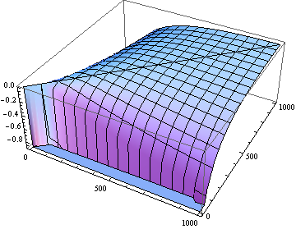


Splay Trees Amortized Cost Analysis
Lemma 1: (i) a_{i} ≤ 3(r’(x) − r(x)) + 1 if the parent of x is the root, and
(ii) a_{i} ≤ 3(r’(x) − r(x)) otherwise.
Case 2 (Zig-Zig / Zag-Zag) : We use the fact that
z
x
y
y
x
Zig-Zig
z
a_{i} ≤ 2+ r’(x)+ r’(z) − r(x) − r(x)

Slide 46
Splay Trees Amortized Cost Analysis
Lemma 1: (i) a_{i} ≤ 3(r’(x) − r(x)) + 1 if the parent of x is the root, and
(ii) a_{i} ≤ 3(r’(x) − r(x)) otherwise.
.
Case 2 (Zig-Zig / Zag-Zag) : We use the fact that
If the splay-step operation transforms the weight-sum function s into s’, we have
z
x
y
y
x
Zig-Zig
z
a_{i} ≤ 2+ r’(x)+ r’(z) − r(x) − r(x)

Slide 47

Splay Trees Amortized Cost Analysis
Lemma 1: (i) a_{i} ≤ 3(r’(x) − r(x)) + 1 if the parent of x is the root, and
(ii) a_{i} ≤ 3(r’(x) − r(x)) otherwise.
Case 2 (Zig-Zig / Zag-Zag)
We have s(x) + s’(z) ≤ s’(x), since T(x) and T’(z) together cover the whole tree except node y. Then the inequality above is:
or
z
x
y
y
x
Zig-Zig
z
a_{i} ≤ 2+ r’(x)+ r’(z) − r(x) − r(x)

Slide 48

Splay Trees Amortized Cost Analysis
Case 2 (Zig-Zig / Zag-Zag)
Therefore,
Lemma 1: (i) a_{i} ≤ 3(r’(x) − r(x)) + 1 if the parent of x is the root, and
(ii) a_{i} ≤ 3(r’(x) − r(x)) otherwise.
z
x
y
y
x
Zig-Zig
z

Slide 49
Splay Trees Amortized Cost Analysis
Lemma 1: (i) a_{i} ≤ 3(r’(x) − r(x)) + 1 if the parent of x is the root, and
(ii) a_{i} ≤ 3(r’(x) − r(x)) otherwise.
Case 3 (Zig-Zag / Zag-Zig): The operation involves two rotations, so the real cost c_{i} = 2.
z
y
x
Zig-Zag
x
y
z

Slide 50

Splay Trees Amortized Cost Analysis
Lemma 1: For a splay-step operation on x that transforms the rank function r into r’, the amortized cost is a_{i} ≤ 3(r’(x) − r(x)) + 1 if the parent of x is the root, and a_{i} ≤ 3(r’(x) − r(x)) otherwise.
Case 3 (Zig-Zag / Zag-Zig): In this case, we have r’(x) = r(z) and r(y) ≥ r(x). Thus the amortized cost is
Note that s’(y) + s’(z) ≤ s’(x). Thus
or
a_{i} = c_{i} + φ’ − φ
= 2 + r’(x) + r’(y) + r’(z) − r(x) − r(y) − r(z)
≤ 2 + r’(y) + r’(z) − r(x) − r(x)
z
y
Zig-Zag
x
x
y
z

Slide 51

Splay Trees Amortized Cost Analysis
Lemma 1: For a splay-step operation on x that transforms the rank function r into r’, the amortized cost is a_{i} ≤ 3(r’(x) − r(x)) + 1 if the parent of x is the root, and a_{i} ≤ 3(r’(x) − r(x)) otherwise.
Case 3 (Zig-Zag / Zag-Zig):
Therefore,
z
y
Zig-Zag
x
x
y
z

Slide 52


Splay Trees Amortized Cost Analysis
Amortized cost of a splay operation: O(logn)
Building on Lemma 1 (amortized cost of splay step),
We proceed to calculate the amortized cost of a complete splay operation.
Lemma 2: The amortized cost of the splay operation on a node x in a splay tree is O(log n).
y
Zig
x
z
y
y
Zig-Zag
x
x
y
z
x

Slide 53
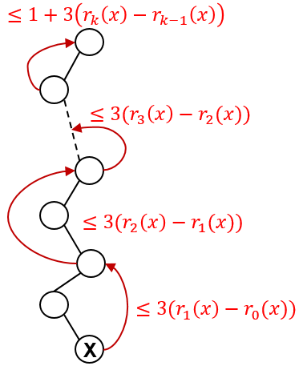

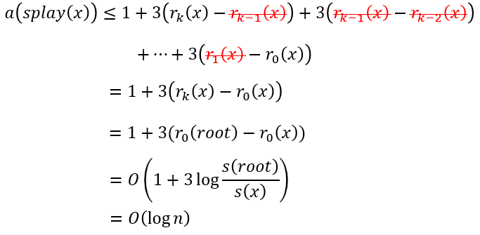
Splay Trees Amortized Cost Analysis
y
Zig
x
z
x
y
y
Zig-Zag
x
x
y
z

Slide 54



Splay Trees Amortized Cost Analysis
Theorem: For any sequence of m operations on a splay tree containing at most n keys, the total real cost is O((m + n)log n).
Proof: Let a_{i} be the amortized cost of the i-th operation. Let c_{i} be the real cost of the i-th operation. Let φ₀ be the potential before and φ_{m} be the potential after the m operations. The total cost of m operations is:
We also have φ₀ − φ_{m} ≤ n log n, since r(x) ≤ log n. So we conclude:
(From )

Slide 55
Range Removal [7, 14]
10
5
17
3
6
13
22
8
16
7
9
Find the maximum value within range (-inf, 7), and splay it to the root.

Slide 56
Range Removal [7, 14]
6
5
10
8
17
3
7
9
13
22
16
Find the minimum value within range (14, +inf), and splay it to the root of the right subtree.

Slide 57
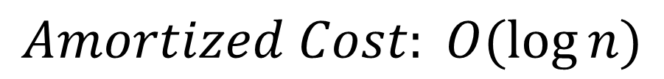
Range Removal [7, 14]
6
5
16
X
10
17
3
8
13
22
[7, 14]
7
9
Cut off the link between the subtree and its parent.

Slide 58
Splay Tree Summary
 | AVL | Splay
Find | O(log n) | Amortized O(log n)
Insert | O(log n) | Amortized O(log n)
Delete | O(log n) | Amortized O(log n)
Range Removal | O(nlog n) | Amortized O(log n)
Memory | More Memory | Less Memory
Implementation | Complicated | Simple

Slide 59
Splay Tree Summary
Can be shown that any M consecutive operations starting from an empty tree take at most O(M log(N))
  → All splay tree operations run in amortized O(log n) time
O(N) operations can occur, but splaying makes them infrequent
Implements most-recently used (MRU) logic
  Splay tree structure is self-tuning

Slide 60
Splay Tree Summary (cont.)
Splaying can be done top-down; better because:
  only one pass
  no recursion or parent pointers necessary
Splay trees are very effective search trees
  relatively simple: no extra fields required
  excellent locality properties:
    frequently accessed keys are cheap to find (near top of tree)
    infrequently accessed keys stay out of the way (near bottom of tree)
Notes:
All-in-all then:
on the topic of locality:
what happens to nodes that never get accessed?
They rarely get splayed and tend to drop to the bottom of the tree (leaving the top for more valuable stuff)
What happens to nodes that are often accessed?
They linger near the top of the tree where they’re cheap to access!

Slide 61
Fibonacci Heaps
Agus Pratondo
Aleksanr Farseev

Slide 62
Fibonacci Heaps: Motivation
It was introduced by Michael L. Fredman and Robert E. Tarjan in 1984 to improve Dijkstra's shortest path algorithm
from O(E log V ) to O(E + V log V ).
Notes:
also led to faster algorithms for Prim's MST algorithm and weighted bipartite matching (assignment problem)
less rigid structure to support more efficient delete-min

Slide 63
Fibonacci Heaps: Structure
each parent < its children
Fibonacci heap.
  Set of heap-ordered trees.
  Maintain pointer to minimum element.
  Set of marked nodes.
roots
heap-ordered tree
17
24
23
7
3
30
26
46
18
52
41
Heap H
35
44
39
Notes:
set -> unordered

Slide 64
Fibonacci Heaps: Structure
Fibonacci heap.
  Set of heap-ordered trees.
  Maintain pointer to minimum element.
  Set of marked nodes.
find-min takes O(1) time
min
17
24
23
7
3
30
26
46
18
52
41
Heap H
35
44
39
Notes:
set -> unordered

Slide 65
Fibonacci Heaps: Structure
Fibonacci heap.
  Set of heap-ordered trees.
  Maintain pointer to minimum element.
  Set of marked nodes.
True if the node lost its child, otherwise it is false
Use to keep heaps flat
Useful in decrease key operation
min
17
24
23
7
3
30
26
46
18
52
41
Heap H
35
marked
44
39
Notes:
set -> unordered

Slide 66
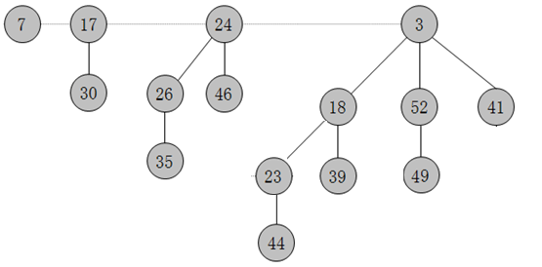
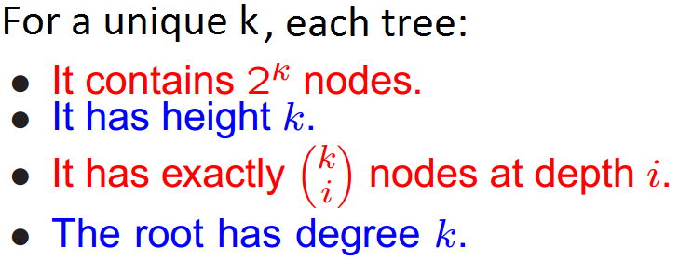
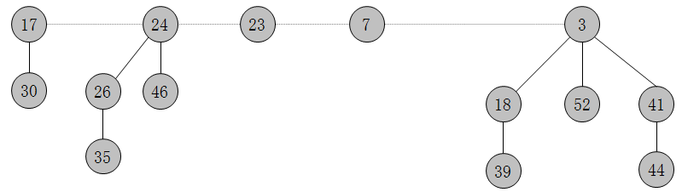
Fibonacci Heap vs. Binomial Heap
Fibonacci Heap is similar to Binomial Heap, but has a less rigid structure
➔the heap is consolidate after the delete-min method is called instead of actively consolidating after each insertion .....This is called a “lazy” heap”....
min

Slide 67
Fibonacci Heaps: Notations
Notations in this slide
  n = number of nodes in heap.
  rank(x) = number of children of node x.
  rank(H) = max rank of any node in heap H.
  trees(H) = number of trees in heap H.
  marks(H) = number of marked nodes in heap H.
trees(H) = 5
marks(H) = 3
n = 14
rank = 3
min
17
24
23
7
3
30
26
46
18
52
41
Heap H
35
marked
44
39
Notes:
recall: with binomial heap, at most one tree of rank 0, 1, 2, 3, 4, …
nodes only change mark in Decrease-Key Can basically ignore marks until then.
marks are used to ensure size of heap is exponential in rank

Slide 68
Fibonacci Heaps: Potential Function
Φ(H) = trees(H) + 2 ⋅ marks(H)
potential of heap H
trees(H) = 5
marks(H) = 3
Φ(H) = 5 + 2⋅3 = 11
min
17
24
23
7
3
30
26
46
18
52
41
Heap H
35
marked
44
39

Slide 69
Insert

Slide 70
Fibonacci Heaps: Insert
Insert.
  Create a new singleton tree.
  Add to root list; update min pointer (if necessary).
insert 21
21
min
17
24
23
7
3
30
26
46
18
52
41
Heap H
35
44
39

Slide 71
Fibonacci Heaps: Insert
Insert.
  Create a new singleton tree.
  Add to root list; update min pointer (if necessary).
insert 21
min
17
24
23
7
21
3
30
26
46
18
52
41
Heap H
35
44
39
Notes:
lazy insert - don't consolidate trees when inserting into Fibonacci heap. If k consecutive inserts, the k 1-node trees are created.

Slide 72
Fibonacci Heaps: Insert Analysis
Actual cost. O(1)
Change in potential. +1
Amortized cost. O(1)
Φ(H) = trees(H) + 2 ⋅ marks(H)
potential of heap H
min
17
24
23
7
21
3
30
26
46
18
52
41
Heap H
35
44
39

Slide 73
Linking Operation
Notes:
extracting min is where the deferred work of consolidating the roots takes place

Slide 74
Linking Operation
Linking operation. Make larger root be a child of smaller root.
larger root
smaller root
15
3
56
24
18
52
41
77
39
44
tree T₁
tree T₂

Slide 75
Linking Operation
Linking operation. Make larger root be a child of smaller root.
15 is larger than 3
➔ Make ‘15’ be a child of ‘3’
larger root
smaller root
15
3
56
24
18
52
41
77
39
44
tree T₁
tree T₂

Slide 76
Linking Operation
Linking operation. Make larger root be a child of smaller root.
15 is larger than 3
➔ Make ‘15’ be a child of ‘3
larger root
smaller root
still heap-ordered
15
3
3
56
24
18
52
41
15
18
52
41
77
39
44
56
24
39
44
tree T₁
tree T₂
77
tree T'

Slide 77
Delete Min
Notes:
extracting min is where the deferred work of consolidating the roots takes place

Slide 78
Fibonacci Heaps: Delete Min
Delete min.
  Delete min; meld its children into root list; update min.
  Consolidate trees so that no two roots have same rank.
min
7
24
23
17
3
30
26
46
18
52
41
35
39
44

Slide 79
Fibonacci Heaps: Delete Min
Delete min.
  Delete min; meld its children into root list; update min.
  Consolidate trees so that no two roots have same rank.
min
7
24
23
17
18
52
41
30
26
46
39
44
35

Slide 80
Fibonacci Heaps: Delete Min
Delete min.
  Delete min; meld its children into root list; update min.
  Consolidate trees so that no two roots have same rank.
min
current
7
24
23
17
18
18
52
41
30
26
46
39
44
35

Slide 81
Fibonacci Heaps: Delete Min
Delete min.
  Delete min; meld its children into root list; update min.
  Consolidate trees so that no two roots have same rank.
rank
0
1
2
3
min
current
7
24
23
17
18
52
41
30
26
46
39
44
35

Slide 82
Fibonacci Heaps: Delete Min
Delete min.
  Delete min; meld its children into root list; update min.
  Consolidate trees so that no two roots have same rank.
rank
0
1
2
3
min
current
7
24
23
17
18
18
52
41
30
26
46
39
44
35

Slide 83
Fibonacci Heaps: Delete Min
Delete min.
  Delete min; meld its children into root list; update min.
  Consolidate trees so that no two roots have same rank.
rank
0
1
2
3
min
7
24
23
17
18
18
52
41
30
26
46
current
39
44
35

Slide 84
Fibonacci Heaps: Delete Min
Delete min.
  Delete min; meld its children into root list; update min.
  Consolidate trees so that no two roots have same rank.
rank
0
1
2
3
min
7
24
23
17
18
18
52
41
30
26
46
current
39
44
35
link 23 into 17

Slide 85
Fibonacci Heaps: Delete Min
Delete min.
  Delete min; meld its children into root list; update min.
  Consolidate trees so that no two roots have same rank.
rank
0
1
2
3
min
7
24
17
18
18
52
41
30
26
46
current
23
39
44
35
link 17 into 7

Slide 86
Fibonacci Heaps: Delete Min
Delete min.
  Delete min; meld its children into root list; update min.
  Consolidate trees so that no two roots have same rank.
rank
0
1
2
3
current
min
24
7
18
18
52
41
26
46
17
30
39
44
35
23
link 24 into 7

Slide 87
Fibonacci Heaps: Delete Min
Delete min.
  Delete min; meld its children into root list; update min.
  Consolidate trees so that no two roots have same rank.
rank
0
1
2
3
current
min
7
18
18
52
41
24
17
30
39
44
26
46
23
35

Slide 88
Fibonacci Heaps: Delete Min
Delete min.
  Delete min; meld its children into root list; update min.
  Consolidate trees so that no two roots have same rank.
rank
0
1
2
3
current
min
7
18
18
52
41
24
17
30
39
44
26
46
23
35

Slide 89
Fibonacci Heaps: Delete Min
Delete min.
  Delete min; meld its children into root list; update min.
  Consolidate trees so that no two roots have same rank.
rank
0
1
2
3
current
min
7
18
18
52
41
24
17
30
39
44
26
46
23
35

Slide 90
Fibonacci Heaps: Delete Min
Delete min.
  Delete min; meld its children into root list; update min.
  Consolidate trees so that no two roots have same rank.
rank
0
1
2
3
current
min
7
18
18
52
41
24
17
30
39
44
26
46
23
link 41 into 18
35

Slide 91
Fibonacci Heaps: Delete Min
Delete min.
  Delete min; meld its children into root list; update min.
  Consolidate trees so that no two roots have same rank.
rank
0
1
2
3
current
min
7
52
18
18
24
17
30
41
39
26
46
23
44
35

Slide 92
Fibonacci Heaps: Delete Min
Delete min.
  Delete min; meld its children into root list; update min.
  Consolidate trees so that no two roots have same rank.
rank
0
1
2
3
current
min
7
52
18
18
24
17
30
41
39
26
46
23
44
35

Slide 93
Fibonacci Heaps: Delete Min
Delete min.
  Delete min; meld its children into root list; update min.
  Consolidate trees so that no two roots have same rank.
min
7
52
18
24
17
30
41
39
26
46
23
44
stop
35

Slide 94
Fibonacci Heaps: Delete Min Analysis
Delete min.
Actual cost. O(rank(H)) + O(trees(H))
  O(rank(H)) to meld min's children into root list.
  O(rank(H)) + O(trees(H)) to update min.
  O(rank(H)) + O(trees(H)) to consolidate trees.
Change in potential. O(rank(H)) - trees(H)
  trees(H' ) ≤ rank(H) + 1 since no two trees have same rank.
  ΔΦ(H) ≤ rank(H) + 1 - trees(H).
Amortized cost. O(rank(H))
Φ(H) = trees(H) + 2 ⋅ marks(H)
potential function
Notes:
O(rank(H)) work adding min's children since at most rank(H) children of min – максимальное количество потомков у минимального корня
O(rank(H) + trees(H)) work updating min since at most this many resulting root nodes – количество корней до + все новые корни - бывшие потомки минимума
O(rank(H) + trees(H)) to consolidate trees since number of roots decreases by 1 after each merging, and there at most rank(H) + trees(H) roots at beginning – слияние корней
trees(H') <= rank(H) + 1 since at worst the roots have degrees 0, 1, 2, …, rank(H)
can scale units in potential function to dominate cost hidden in O(trees(H))
number of marked nodes marked(H) does not increase [Note: you unmark a root y when it is linked to another root, though this case does not arise in the example]

Slide 95
Decrease Key

Slide 96
Fibonacci Heaps: Decrease Key
Intuition for deceasing the key of node x.
  If heap-order is not violated, just decrease the key of x.
  Otherwise, cut tree rooted at x and meld into root list.
  To keep trees flat: as soon as a node has its second child cut,
  cut it off and meld into root list (and unmark it).
min
7
18
38
marked node:
one child already cut
24
17
23
21
39
41
26
46
30
52
35
88
72
Notes:
If decreasing the key of node i makes it violate heap order property, we can cutout subtree rooted at i and meld it into heap.
To keep trees bushy, we limit the number of cuts among the children of any vertex to 2.
Use the mark of a node to designate whether or not it has had one child cut off

Slide 97
Fibonacci Heaps: Decrease Key
Case 1. [heap order not violated]
  Decrease key of x.
  Change heap min pointer (if necessary).
min
7
18
18
38
24
17
23
21
39
41
26
46
29
30
52
x
35
88
72
decrease-key of x from 46 to 29

Slide 98
Fibonacci Heaps: Decrease Key
Case 1. [heap order not violated]
  Decrease key of x.
  Change heap min pointer (if necessary).
min
7
18
18
38
24
17
23
21
39
41
26
29
30
52
x
35
88
72
decrease-key of x from 46 to 29

Slide 99
Fibonacci Heaps: Decrease Key
Case 2a. [heap order violated]
  Decrease key of x.
  Cut tree rooted at x, meld into root list, and unmark.
  If parent p of x is unmarked (hasn't yet lost a child), mark it;
  Otherwise, cut p, meld into root list, and unmark
  (and do so recursively for all ancestors that lose a second child).
min
7
18
18
38
24
17
23
21
39
41
p
26
29
30
52
15
x
35
88
72
decrease-key of x from 29 to 15

Slide 100
Fibonacci Heaps: Decrease Key
Case 2a. [heap order violated]
  Decrease key of x.
  Cut tree rooted at x, meld into root list, and unmark.
  If parent p of x is unmarked (hasn't yet lost a child), mark it;
  Otherwise, cut p, meld into root list, and unmark
  (and do so recursively for all ancestors that lose a second child).
min
7
18
18
38
24
17
23
21
39
41
p
26
15
30
52
x
35
88
72
decrease-key of x from 29 to 15

Slide 101
Fibonacci Heaps: Decrease Key
Case 2a. [heap order violated]
  Decrease key of x.
  Cut tree rooted at x, meld into root list, and unmark.
  If parent p of x is unmarked (hasn't yet lost a child), mark it;
  Otherwise, cut p, meld into root list, and unmark
  (and do so recursively for all ancestors that lose a second child).
x
min
15
7
18
18
38
72
24
17
23
21
39
41
p
26
30
52
35
88
decrease-key of x from 29 to 15

Slide 102
Fibonacci Heaps: Decrease Key
Case 2a. [heap order violated]
  Decrease key of x.
  Cut tree rooted at x, meld into root list, and unmark.
  If parent p of x is unmarked (hasn't yet lost a child), mark it;
  Otherwise, cut p, meld into root list, and unmark
  (and do so recursively for all ancestors that lose a second child).
x
min
15
7
18
18
38
72
24
24
17
23
21
39
41
mark parent
p
26
30
52
35
88
decrease-key of x from 29 to 15

Slide 103
Fibonacci Heaps: Decrease Key
Case 2b. [heap order violated]
  Decrease key of x.
  Cut tree rooted at x, meld into root list, and unmark.
  If parent p of x is unmarked (hasn't yet lost a child), mark it;
  Otherwise, cut p, meld into root list, and unmark
  (and do so recursively for all ancestors that lose a second child).
min
15
7
18
18
38
72
24
24
17
23
21
39
41
p
26
30
52
35
88
decrease-key of x from 35 to 5
x
5

Slide 104
Fibonacci Heaps: Decrease Key
Case 2b. [heap order violated]
  Decrease key of x.
  Cut tree rooted at x, meld into root list, and unmark.
  If parent p of x is unmarked (hasn't yet lost a child), mark it;
  Otherwise, cut p, meld into root list, and unmark
  (and do so recursively for all ancestors that lose a second child).
min
15
7
18
18
38
72
24
24
17
23
21
39
41
p
26
30
52
x
5
88
decrease-key of x from 35 to 5

Slide 105
Fibonacci Heaps: Decrease Key
Case 2b. [heap order violated]
  Decrease key of x.
  Cut tree rooted at x, meld into root list, and unmark.
  If parent p of x is unmarked (hasn't yet lost a child), mark it;
  Otherwise, cut p, meld into root list, and unmark
  (and do so recursively for all ancestors that lose a second child).
min
x
15
5
7
18
18
38
72
24
24
17
23
21
39
41
p
26
30
52
88
decrease-key of x from 35 to 5

Slide 106
Fibonacci Heaps: Decrease Key
Case 2b. [heap order violated]
  Decrease key of x.
  Cut tree rooted at x, meld into root list, and unmark.
  If parent p of x is unmarked (hasn't yet lost a child), mark it;
  Otherwise, cut p, meld into root list, and unmark
  (and do so recursively for all ancestors that lose a second child).
min
x
15
5
7
18
18
38
72
24
24
17
23
21
39
41
second child cut
p
26
30
52
88
decrease-key of x from 35 to 5

Slide 107
Fibonacci Heaps: Decrease Key
Case 2b. [heap order violated]
  Decrease key of x.
  Cut tree rooted at x, meld into root list, and unmark.
  If parent p of x is unmarked (hasn't yet lost a child), mark it;
  Otherwise, cut p, meld into root list, and unmark
  (and do so recursively for all ancestors that lose a second child).
min
x
p
15
5
26
7
18
18
38
88
24
72
24
17
23
21
39
41
30
52
decrease-key of x from 35 to 5

Slide 108
Fibonacci Heaps: Decrease Key
Case 2b. [heap order violated]
  Decrease key of x.
  Cut tree rooted at x, meld into root list, and unmark.
  If parent p of x is unmarked (hasn't yet lost a child), mark it;
  Otherwise, cut p, meld into root list, and unmark
  (and do so recursively for all ancestors that lose a second child).
min
x
p
15
5
26
7
18
18
38
88
24
72
p'
24
17
23
21
39
41
30
52
second child cut
decrease-key of x from 35 to 5

Slide 109
Fibonacci Heaps: Decrease Key
Case 2b. [heap order violated]
  Decrease key of x.
  Cut tree rooted at x, meld into root list, and unmark.
  If parent p of x is unmarked (hasn't yet lost a child), mark it;
  Otherwise, cut p, meld into root list, and unmark
  (and do so recursively for all ancestors that lose a second child).
min
x
p
p'
p''
15
5
26
24
7
18
18
38
72
88
don't mark
parent if
it's a root
17
23
21
39
41
30
52
decrease-key of x from 35 to 5
Notes:
Note: when a root is linked into another root (in delete-min consolidation phase), we unmark it
Q. How can a root node ever be marked?
A. In delete-min we delete a root node, but promote all of its (potentially) marked children to be roots.

Slide 110
Fibonacci Heaps: Decrease Key Analysis
Decrease-key.
Actual cost. O(c)
  O(1) time for changing the key.
  O(1) time for each of c cuts, plus melding into root list.
Change in potential. O(1) - c
  trees(H') = trees(H) + c.
  marks(H') ≤ marks(H) - c + 2.
  ΔΦ ≤ c + 2 ⋅ (-c + 2) = 4 - c.
Amortized cost. O(1)
Φ(H) = trees(H) + 2 ⋅ marks(H)
potential function
Notes:
When marked node y is cut by cascading cut, its mark bit is cleared (2 units of potential).
One unit pays for cut, the other for unit increase in potential due to y becoming a root.
marks(H') <= marks(H) - c + 2: each cut (except first) unmarks a node; last cut may or may not mark a node
Can scale units of potential to dominate cost hidden in O(c) term

Slide 111
Analysis

Slide 112
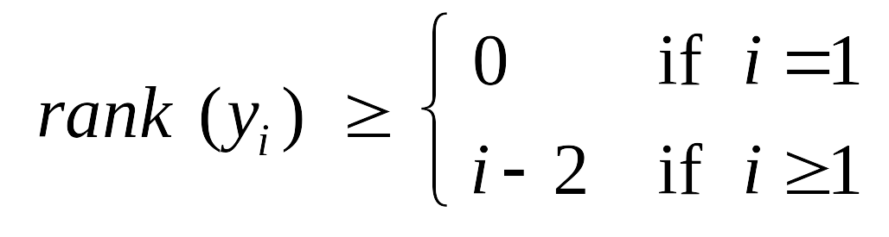
Fibonacci Heaps: Bounding the Rank
Lemma. Fix a point in time. Let x be a node, and let y₁, …, y_{k} denote
its children in the order in which they were linked to x. Then:
Def. Let F_{k} be smallest possible tree of rank k satisfying property.
x
y₁
y₂
…
y_{k}
F₀
F₁
F₂
F₃
F₄
F₅
1
2
3
5
8
13
Notes:
slightly non-standard definition of fibonacci with f0 = 1, f1 = 2

Slide 113
Fibonacci Heaps: Bounding the Rank
Lemma. Fix a point in time. Let x be a node, and let y₁, …, y_{k} denote
its children in the order in which they were linked to x. Then:
Def. Let F_{k} be smallest possible tree of rank k satisfying property.
x
y₁
y₂
…
y_{k}
F₄
F₅
F₆
8
13
8 + 13 = 21
Notes:
slightly non-standard definition of fibonacci with f0 = 1, f1 = 2

Slide 114
Fibonacci Heaps: Bounding the Rank
Lemma. Fix a point in time. Let x be a node, and let y₁, …, y_{k} denote
its children in the order in which they were linked to x. Then:
Def. Let F_{k} be smallest possible tree of rank k satisfying property.
Fibonacci fact. F_{k} ≥ φ^{k}, where φ = (1 + √5) / 2 ≈ 1.618.
Corollary. rank(H) ≤ log_{φ} n .
x
y₁
y₂
…
y_{k}
golden ratio

Slide 115
Fibonacci Numbers

Slide 116
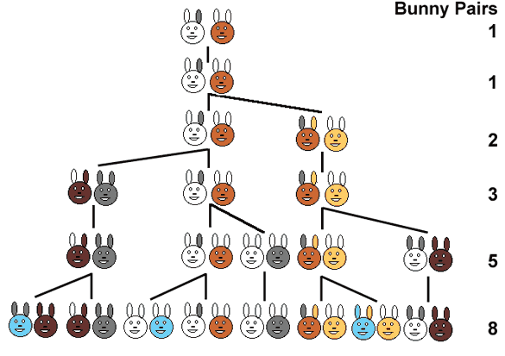
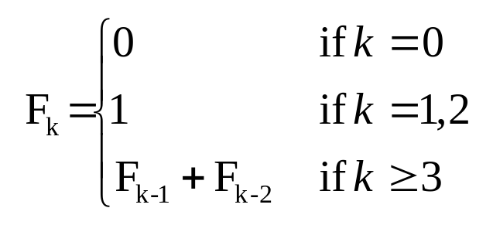
Fibonacci Numbers: Exponential Growth
Def. The Fibonacci sequence is: 0, 1, 1, 2, 3, 5, 8, 13, 21, …

Slide 117
Union

Slide 118
Fibonacci Heaps: Union
Union. Combine two Fibonacci heaps.
Representation. Root lists are circular, doubly linked lists.
min
min
23
24
17
7
3
21
30
26
46
18
52
41
Heap H'
35
Heap H''
44
39

Slide 119
Fibonacci Heaps: Union
Union. Combine two Fibonacci heaps.
Representation. Root lists are circular, doubly linked lists.
min
23
24
17
7
3
21
30
26
46
18
52
41
35
Heap H
44
39

Slide 120
Fibonacci Heaps: Union
Actual cost. O(1)
Change in potential. 0
Amortized cost. O(1)
Φ(H) = trees(H) + 2 ⋅ marks(H)
potential function
min
23
24
17
7
3
21
30
26
46
18
52
41
35
Heap H
44
39

Slide 121
Delete

Slide 122
Fibonacci Heaps: Delete
Delete node x.
  decrease-key of x to -∞.
  delete-min element in heap.
Amortized cost. O(rank(H))
  O(1) amortized for decrease-key.
  O(rank(H)) amortized for delete-min.
Φ(H) = trees(H) + 2 ⋅ marks(H)
potential function

Slide 123

Application:
Priority Queues => ex.Shortest path problem
Operation
Binomial
Heap
Fibonacci
Heap †
make-heap
1
1
is-empty
1
1
insert
log n
1
delete-min
log n
log n
decrease-key
log n
1
delete
log n
log n
union
log n
1
find-min
log n
1
n = number of elements in priority queue
† amortized
Notes:
main improvement: decrease-key is now O(1)
we'll emphasize the first 5 ops

Slide 124
Persistent Data Structures
Li Furong
Song Chonggang

Slide 125
Motivation
Version Control
  Suppose we consistently modify a data structure
  Each modification generates a new version of this structure
  A persistent data structure supports queries of all the previous versions of itself
  Three types of data structures
    Fully persistent
      all versions can be queried and modified
    Partially persistent
      all versions can be queried, only the latest version can be modified
    Ephemeral
      only can access the latest version

Slide 126
Making Data Structures Persistent
In the following talk, we will
  Make pointer-based data structures persistent, e.g., tree
  Discussions are limited to partial persistence
Three methods
  Fat nodes
  Path copying
  Node Copying (Sleator, Tarjan et al.)

Slide 127
Fat Nodes
Add a modification history to each node
  Modification
    append the new data to the modification history, associated with timestamp
  Access
    for each node, search the modification history to locate the desired version
  Complexity (Suppose m modifications)
value
time₁
value
time₂
 | Time | Space
Modification | O(1) | O(1)
Access | O(log m) per node

Slide 128
Path Copying
Copy the node before changing it
Cascade the change back until root is reached

Slide 129
Path Copying
Copy the node before changing it
Cascade the change back until root is reached
0
version 0:
version 1:
Insert (2)
version 2:
Insert (4)
5
1
7
3

Slide 130
Path Copying
Copy the node before changing it
Cascade the change back until root is reached
0
version 1:
Insert (2)
5
1
7
3
3
2

Slide 131
Path Copying
Copy the node before changing it
Cascade the change back until root is reached
0
version 1:
Insert (2)
5
1
7
3
3
2

Slide 132
Path Copying
Copy the node before changing it
Cascade the change back until root is reached
0
1
version 1:
Insert (2)
5
5
1
1
7
3
3
2

Slide 133
Path Copying
Copy the node before changing it
Cascade the change back until root is reached
0
1
2
version 1:
Insert (2)
version 2:
Insert (4)
5
5
5
1
1
1
7
3
3
3
2
4

Slide 134
Path Copying
Copy the node before changing it
Cascade the change back until root is reached
  Each modification creates a new root
  Maintain an array of roots indexed by timestamps
0
1
2
version 1:
Insert (2)
version 2:
Insert (4)
5
5
5
1
1
1
7
3
3
3
2
4

Slide 135
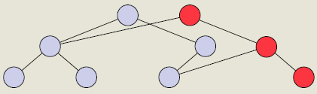
Path Copying
Copy the node before changing it
Cascade the change back until root is reached
  Modification
    copy the node to be modified and its ancestors
  Access
    search for the correct root, then access as original structure
  Complexity (Suppose m modifications, n nodes)
 | Time | Space
Modification | Worst: O(n) Average: O(log n) | Worst: O(n) Average: O(log n)
Access | O(log m)

Slide 136
Node Copying
Fat nodes: cheap modification, expensive access
Path copying: cheap access, expensive modification
Can we combine the advantages of them?
Extend each node by a timestamped modification box
  A modification box holds at most one modification
  When modification box is full, copy the node and apply the modification
  Cascade change to the node‘s parent

Slide 137
Node Copying
5
1
7
3
version 0
version 1:
Insert (2)
version 2:
Insert (4)
k
lp
mbox
rp

Slide 138
Node Copying
5
1
7
3
version 0:
version 1:
Insert (2)
1 lp
2
edit modification box directly
like fat nodes

Slide 139
Node Copying
5
1
7
3
3
version 1:
Insert (2)
version 2:
Insert (4)
1 lp
1 lp
2
4
copy the node to be modified

Slide 140
Node Copying
5
1
7
3
3
version 1:
Insert (2)
version 2:
Insert (4)
1 lp
2
4
apply the modification in modification box

Slide 141
Node Copying
5
1
7
3
3
version 1:
Insert (2)
version 2:
Insert (4)
1 lp
2
4
perform new modification directly
the new node reflects the latest status

Slide 142
Node Copying
5
1
7
2 rp
3
3
version 1:
Insert (2)
version 2:
Insert (4)
1 lp
2
4
cascade the change to its parent
like path copying

Slide 143
Node Copying
  Modification
    if modification box empty, fill it
    otherwise, make a copy of the node, using the latest values
    cascade this change to the node’s parent (which may cause node copying recursively)
    if the node is a root, add a new root
  Access
    search for the correct root, check modification box
  Complexity (Suppose m modifications)
 | Time | Space
Modification | Amortized: O(1) | Amortized: O(1)
Access | O(log m) + O(1) per node

Slide 144
Modification Complexity Analysis
Use the potential technique
  Live nodes
    Nodes that comprise the latest version
  Full live nodes
    live nodes whose modification boxes are full
  Potential function f (T)
    number of full live nodes in T (initially zero)
  Each modification involves k number of copies
    each with a O(1) space and time cost
    decrease the potential function by 1-> change a full modification box into an empty one
  Followed by one change to a modification box (or add a new root)
  Δ f = 1-k
  Space cost: O(k+ Δ f ) = O(k+1–k) = O(1)
  Time cost: O(k+1+Δ f) = O(1)

Slide 145
Applications
  Grounded 2-Dimensional Range Searching
  Planar Point Location
  Persistent Splay Tree

Slide 146
Applications: Grounded 2-Dimensional Range Searching
  Problem
    Given a set of n points and a query triple (a,b,i)
    Report the set of points (x,y), where a<x<b and y<i
y
i
a
b
x

Slide 147
Applications: Grounded 2-Dimensional Range Searching
  Resolution
    Consider each y value as a version, x value as a key
    Insert each node in ascending order of y value
    Version i contains every point for which y<i
    Report all points in version i whose key value is in [a,b]

Slide 148
Applications: Grounded 2-Dimensional Range Searching
  Resolution
    Consider each y value as a version, x value as a key
    Insert each node in ascending order of y value
    Version i contains every point for which y<i
    Report all points in version i whose key value is in [a,b]
i
a
b
  Preprocessing
    Space required O(n) with Node Copying and O(n log n) with Path Copying
  Query time O(log n)

Slide 149
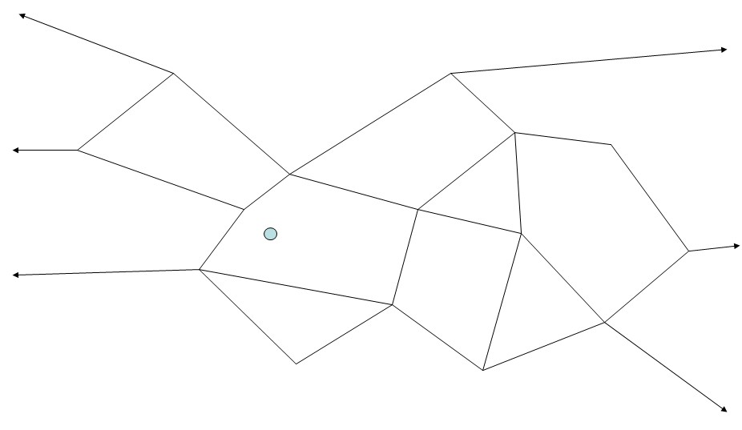
Applications: Planar Point Location
  Problem
    Suppose the Euclidian plane is divided into polygons by n line segments that intersect only at their endpoints
    Given a query point in the plane, the Planar Point Location problem is to determine which polygon contains the point

Slide 150
Applications: Planar Point Location
  Solution
    Partition the plane into vertical slabs by drawing a vertical line through each endpoint
    Within each slab, the lines are ordered
    Allocate a search tree on the x-coordinates of the vertical lines
    Allocate a search tree per slab containing the lines and with each line associate the polygon above it

Slide 151
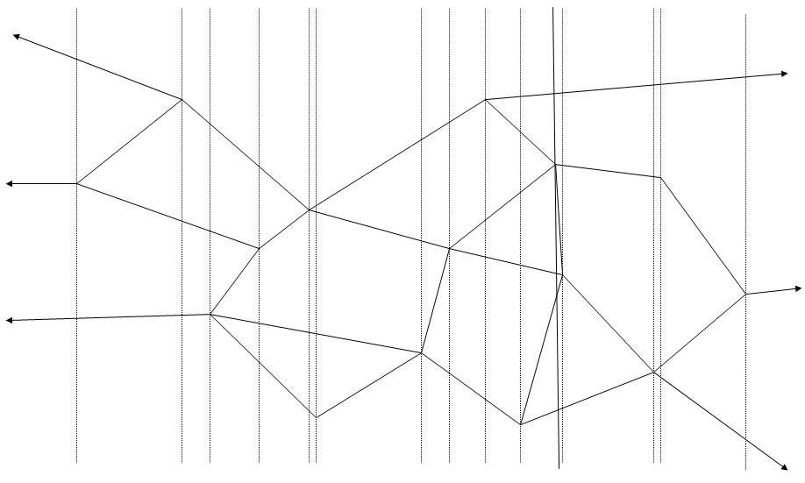
Applications: Planar Point Location
  Answer a Query (x,y)
    First, find the appropriate slab
    Then, search the slab to find the polygon
slab

Slide 152
Applications: Planar Point Location
  Simple Implementation
    Each slab needs a search tree, each search tree is not related to each other
    Space cost is high: O(n) for vertical lines, O(n) for lines in each slab
  Key Observation
    The list of the lines in adjacent slabs are related
      The same line
      End and start
  Resolution
    Create the search tree for the first slab
    Obtain the next one by deleting the lines that end at the corresponding vertex and adding the lines that start at that vertex

Slide 153
Applications: Planar Point Location
1
2
3
First slab

Slide 154
Applications: Planar Point Location
1
2
3
First slab
Second slab

Slide 155
Applications: Planar Point Location
1
1
2
3
First slab
Second slab

Slide 156
Applications: Planar Point Location
1
1
2
3
First slab
Second slab

Slide 157
Applications: Planar Point Location
1
1
4
2
5
3
First slab
Second slab

Slide 158
Applications: Planar Point Location
1
1
4
2
5
3
3
First slab
Second slab

Slide 159
Applications: Planar Point Location
  Preprocessing
    2n insertions and deletions
    Time cost O(n) with Node Copying, O(n log n) with Path Copying
  Space cost O(n) with Node Copying, O(n log n) with Path Copying

Slide 160
Applications: Splay Tree
  Persistent Splay Tree
    With Node Copying, we can access previous versions of the splay tree
  Example
0
5
3
1

Slide 161
Applications: Splay Tree
  Persistent Splay Tree
    With Node Copying, we can access previous versions of the splay tree
  Example
0
5
3
splay
1
1

Slide 162
Applications: Splay Tree
  Persistent Splay Tree
    With Node Copying, we can access previous versions of the splay tree
  Example
0
1
5
1
3
3
splay
1
1
5

Slide 163
Applications: Splay Tree
0
5
3
1

Slide 164
Applications: Splay Tree
0
0
5
5
0
3
3
1 rp
1
0
1
1
1
1 rp
1

Slide 165
Summary
Hong Hande

Slide 166
Splay tree
  Advantage
    Simple implementation
    Comparable performance
    Small memory footprint
    Self-optimizing
  Disadvantage
    Worst case for single operation can be O(n)
    Extra management in a multi-threaded environment

Slide 167
Fibonacci Heap
  Advantage
    Better amortized running time than a binomial heap
    Lazily defer consolidation until next delete-min
  Disadvantage
    Delete and delete minimum have linear running time in the worst case
    Not appropriate for real-time systems

Slide 168
Persistent Data Structure
  Concept
    A persistent data structure supports queries of all the previous versions of itself
  Three methods
    Fat nodes
    Path copying
    Node Copying (Sleator, Tarjan et al.)
  Good performance in multi-threaded environments.

Slide 169
Key Word to Remember
  Splay Tree --- Self-optimizing AVL tree
  Fibonacci Heap --- Lazy version of Binomial Heap
  Persistent Data Structure --- Extra space for previous version
Thank you!
Q & A

